Slide 1
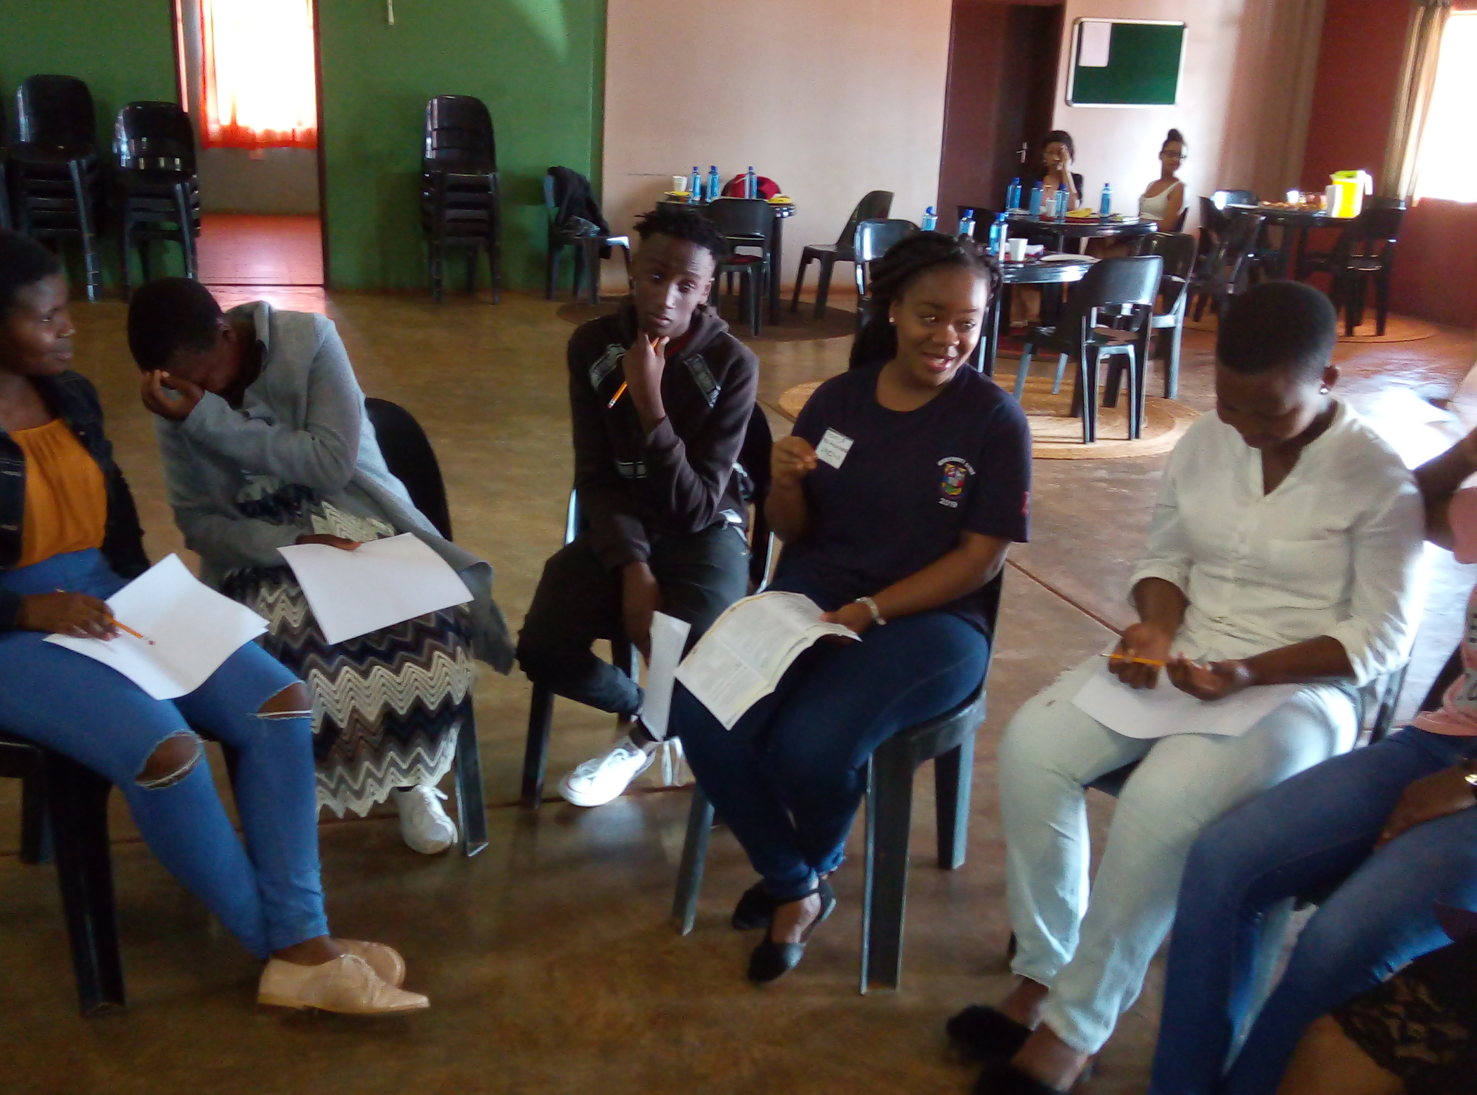
Counselling, Career & Development Unit (CCDU)
WELCOMING 1ST YEARS TO THE
First-Year Orientation Program 2021/2022

Slide 2
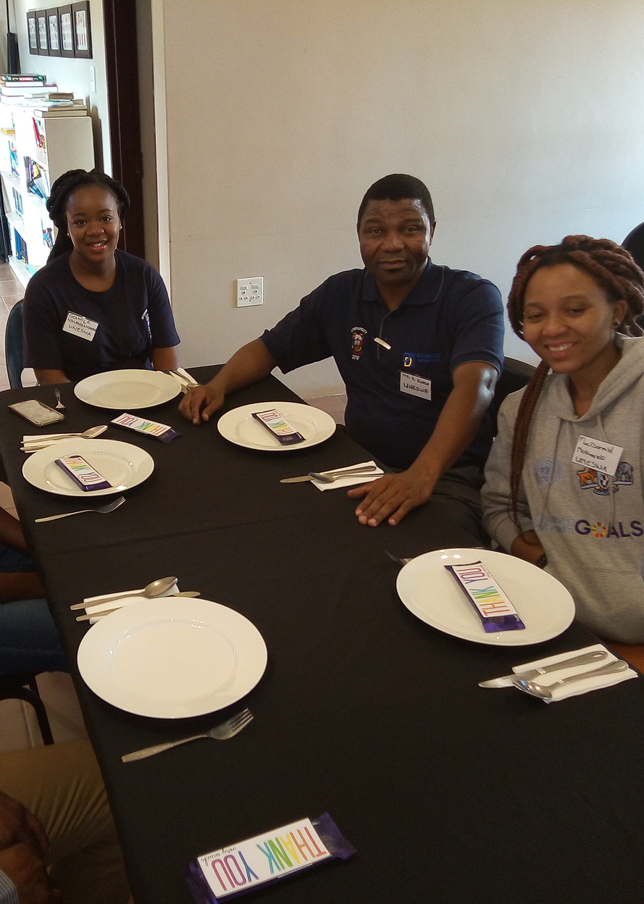
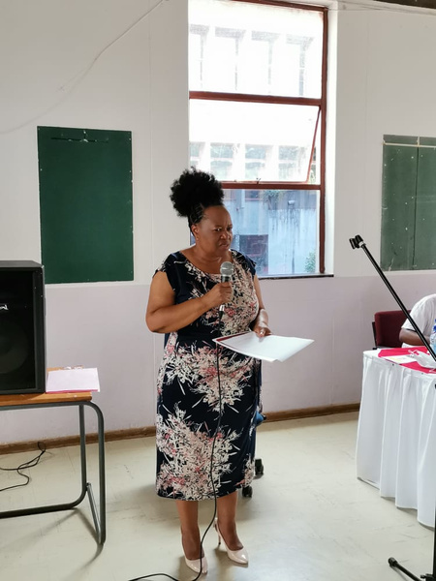
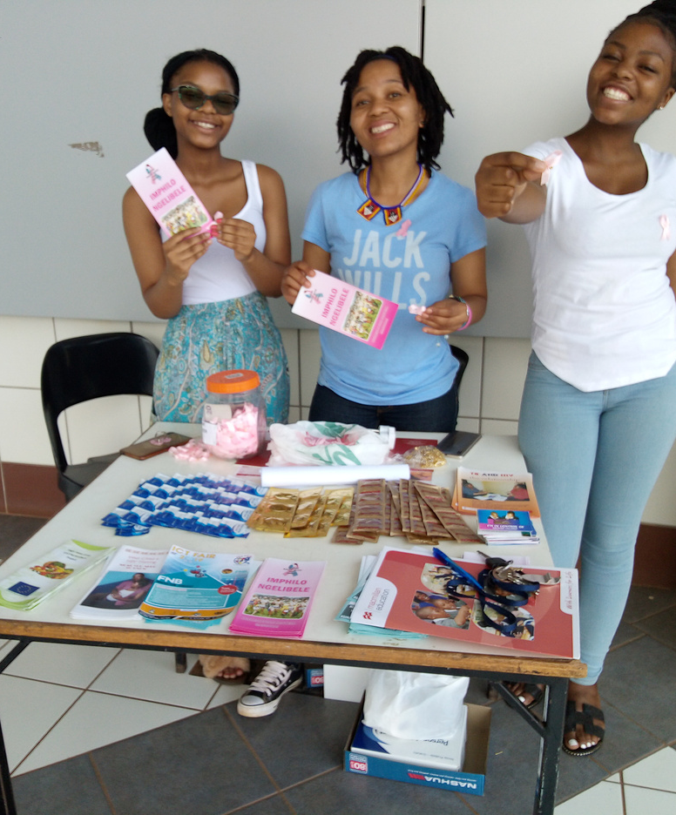
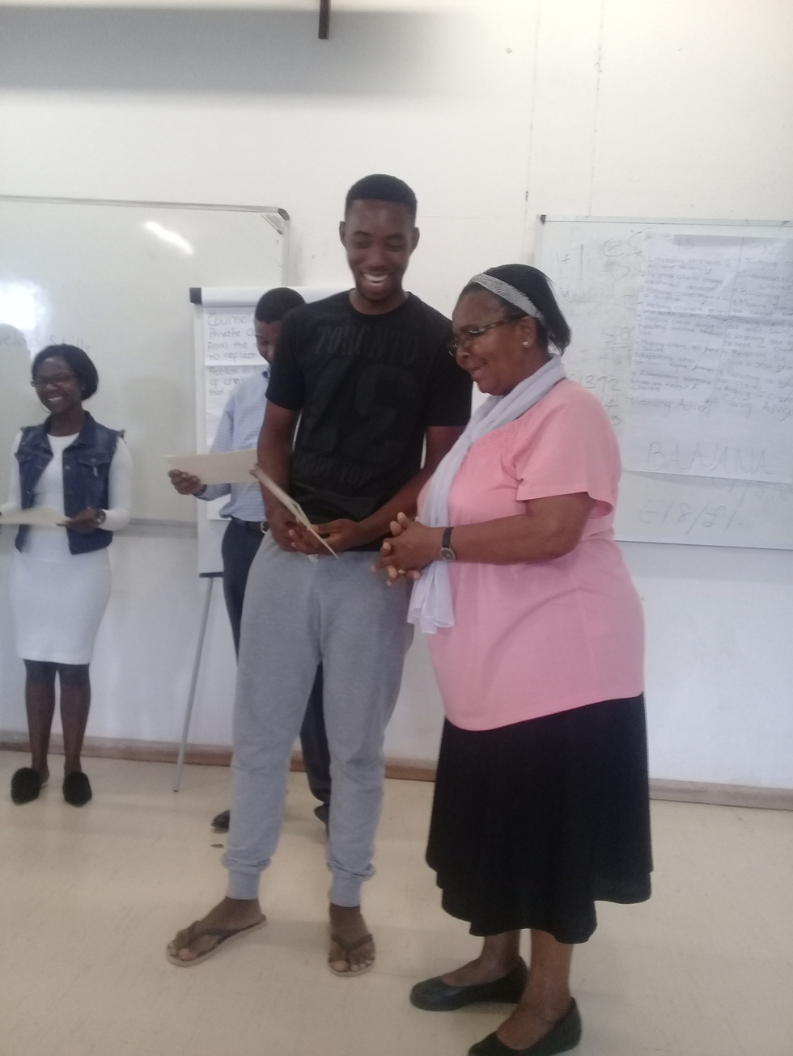
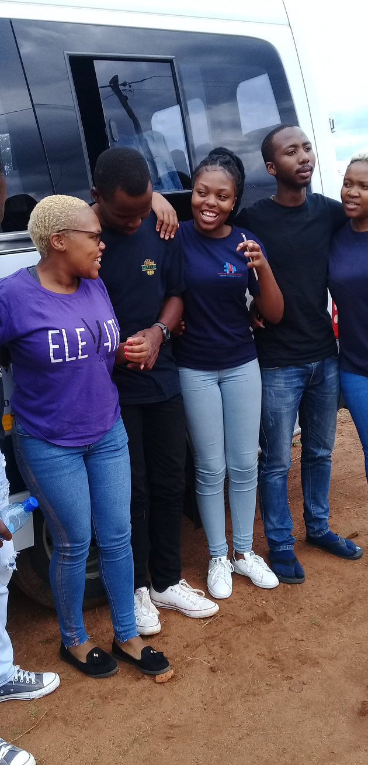
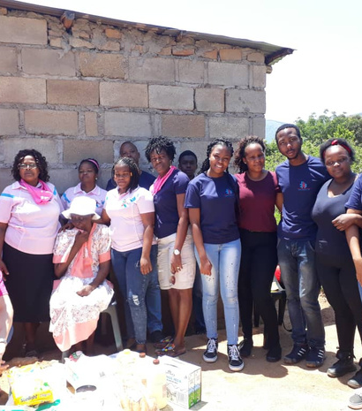
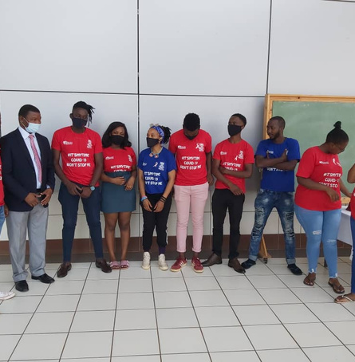
CCDU UNDER LENS

Slide 3
THE VISION, MISSION AND VALUES OF THE CCDU
VISION
MISSION
VALUES
The leading Centre for Students Counselling, Career & Development
To be responsive to diverse students psychosocial needs, through advancement and development of personal, academic and career goals.
-Integrity
-Professionalism
-Accountability
-Confidentiality
-Respect

Slide 4
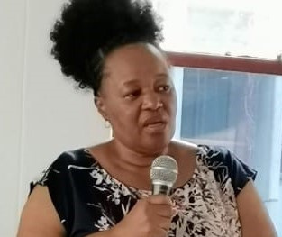
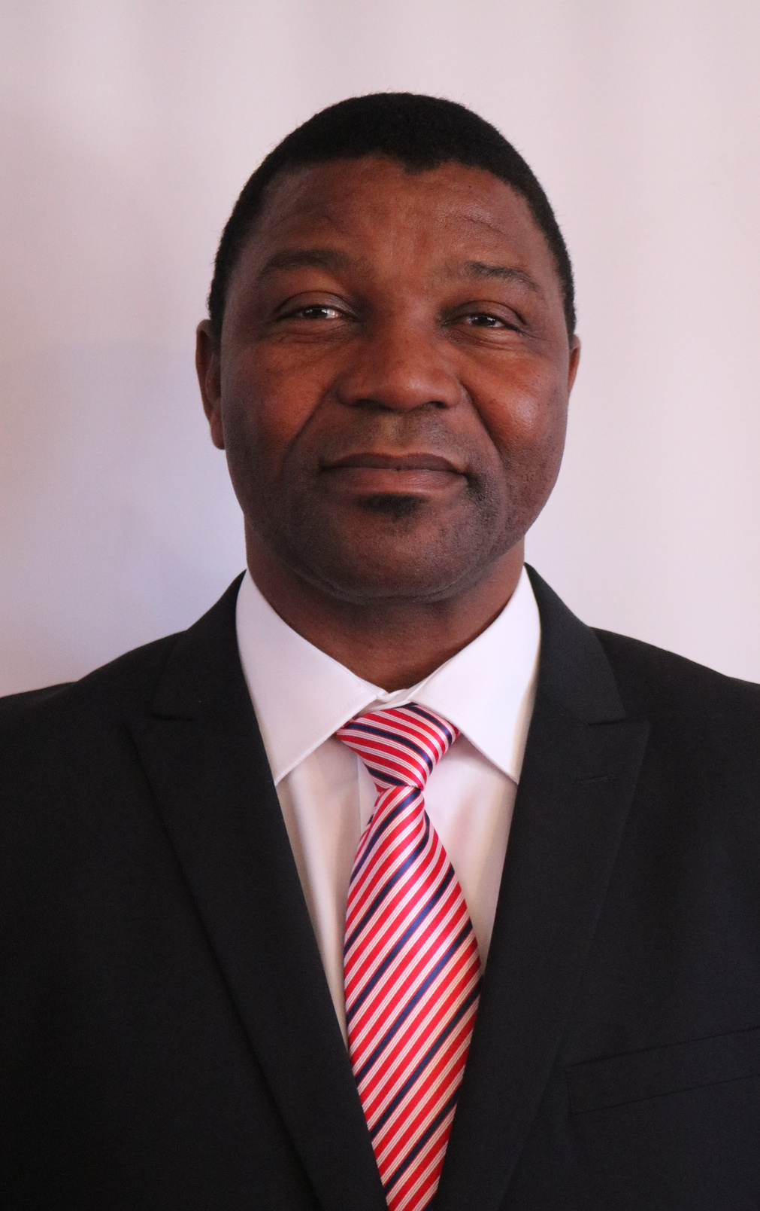
INTRODUCTION OF STAFF
Based at Luyengo Campus, Snr. Assistant Dean of Students Affairs
Based at Kwaluseni Campus, Assistant Dean of Students Affairs
Mrs. T Mamba
Mr. B. Kunene

Slide 5
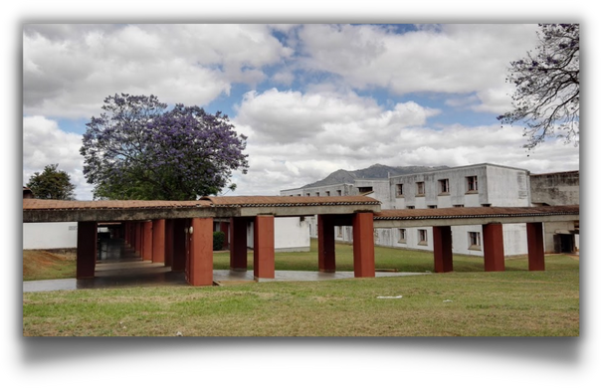
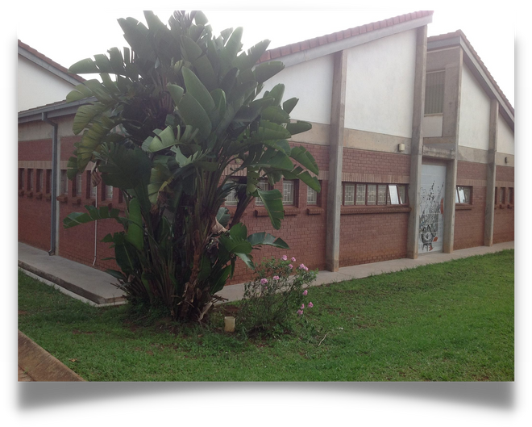
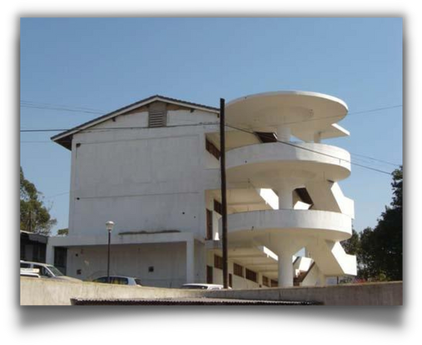
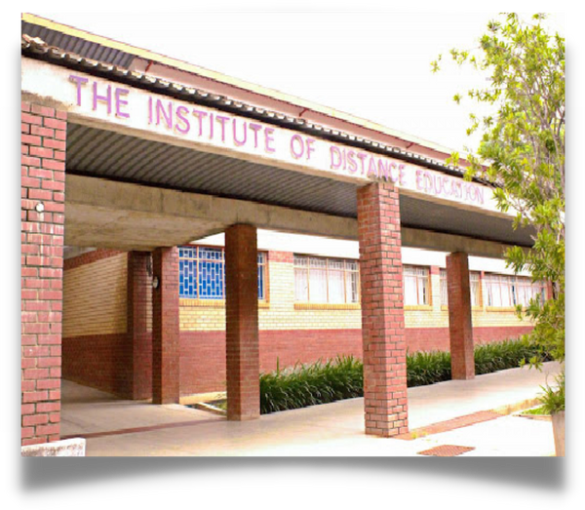
CCDU Location and Contacts
KWALUSENI
Lomawa Residence Hall East corner entrance, Adjacent Faculty of Science Engineering
LUYENGO
Student Union Building
2527 0599
2017 0143
Email: tmamba@uniswa.sz
Emaill: bkunene@uniswa.sz
IDE KWALUSENI
MBABANE
See Students Support
Services
Assistant DSA's
2407 0717
2517 0275
Email: hmaziya@uniswa.sz
Email: nmabuza@uniswa.sz
Central Email: counselling@uniswa.sz

Slide 6
What Services Does CCDU Offer?
Counselling servies are provided at campus level:
Counselling And Psychological Services
Psychosocial support
Counselling
Guidance
Referrals
Prospective student consultations
Personal guidance and development
Academic Enhancement
Study skills
Orientation
Academic counselling and guidance
Mentorship
Testimonials
Examination/test taking coping skills training
Career assessment

Slide 7
How Do We Get Students As An Office
We mainly rely on:
And Connect With:
Peer Counsellors & Educators
Lectures
Staff- Academic & Non-Academic
Mentors
Living & Learning Committees
(House Committees)
Christian Communities
Clubs and Societies
Students Representive Council
Class Representatives
Student Interns
International Students

Slide 8
Who Visits the CCDU?
Registered students, graduates and prospective students
Any one wishing to talk and wishing to be listened to
Anyone with a concern, an issue or a problem, big or small.
Come in for counselling as individuals or as a group
You can come to seek for information or knowledge on anything- we do refer for information and help for information that is not available with us.

Slide 9
PEER COUNSELLORS AND EDUCATORS (PCE)
We coordinate the operations of the Peer Counsellors and Educators
•This is a group of student volunteers who commit themselves to the wellness of both themselves and other students who seek help with them
•PCE involve themselves with counselling and education activities and are trained to handle issues at hand

Slide 10
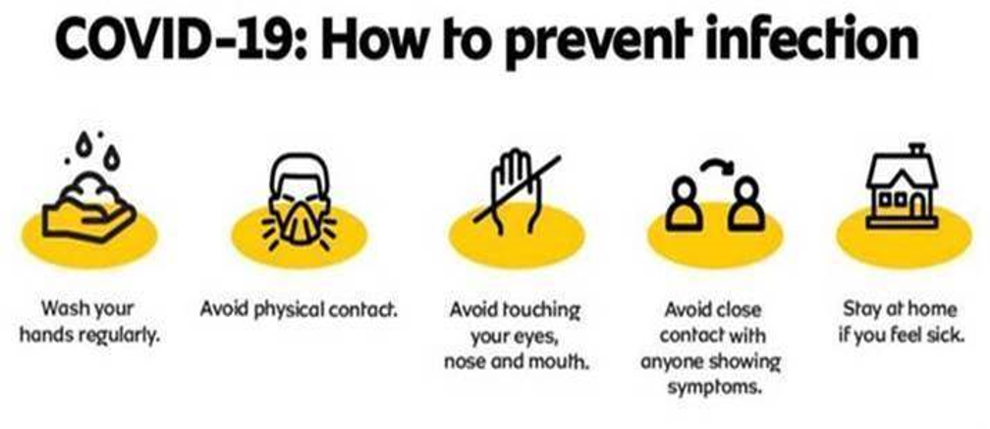
Remember To Protect Yourself and Others from Coronavirus

